Slide 1
Cipher Problems
Programming Club

Slide 2
Caesar Cipher
The Caesar cipher is one of the earliest known and simplest ciphers. It is a type of substitution cipher in which each letter in the plaintext is 'shifted' a certain number of places down the alphabet. For example, with a shift of 1, A would be replaced by B, B would become C, and so on.
To pass an encrypted message from one person to another, it is first necessary that both parties have the 'key' for the cipher, so that the sender may encrypt it and the receiver may decrypt it. For the caesar cipher, the key is the number of characters to shift the cipher alphabet.

Slide 3

Caesar Cipher
Here is a quick example of the encryption and decryption steps involved with the caesar cipher. The text we will encrypt is 'defend the east wall of the castle', with a shift (key) of 1.

Slide 4
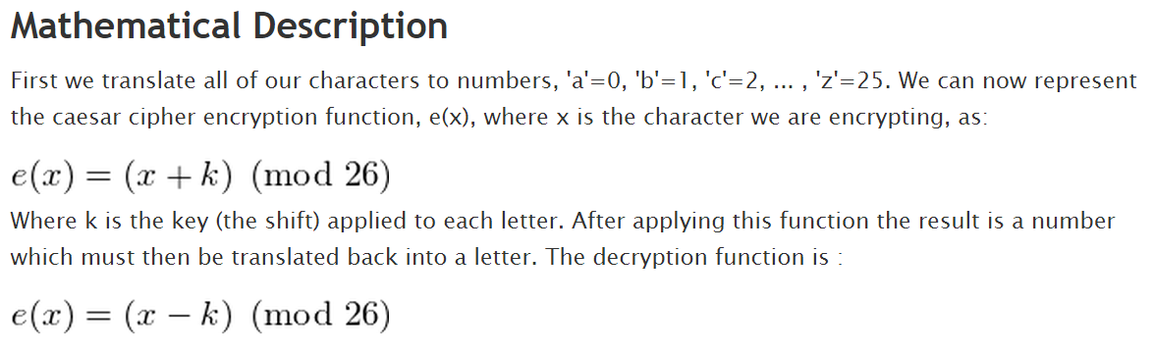
Caesar Cipher

Slide 5
Caesar Cipher
Using a shift of 5 decrypt the following:
ymjwjnxstbfdnhfsljyymnxbwtsl

Slide 6


Simple Substitution Cipher
It basically consists of substituting every plaintext character for a different ciphertext character. It differs from the Caesar cipher in that the cipher alphabet is not simply the alphabet shifted, it is completely jumbled.
An example encryption using the above key:

Slide 7
Simple Substitution Cipher
Using the key: phqgiumeaylnofdxjkrcvstzwb
Decrypt: xkdmkpooafmqnvhardfodfgpwrpfgukagpwr

Slide 8
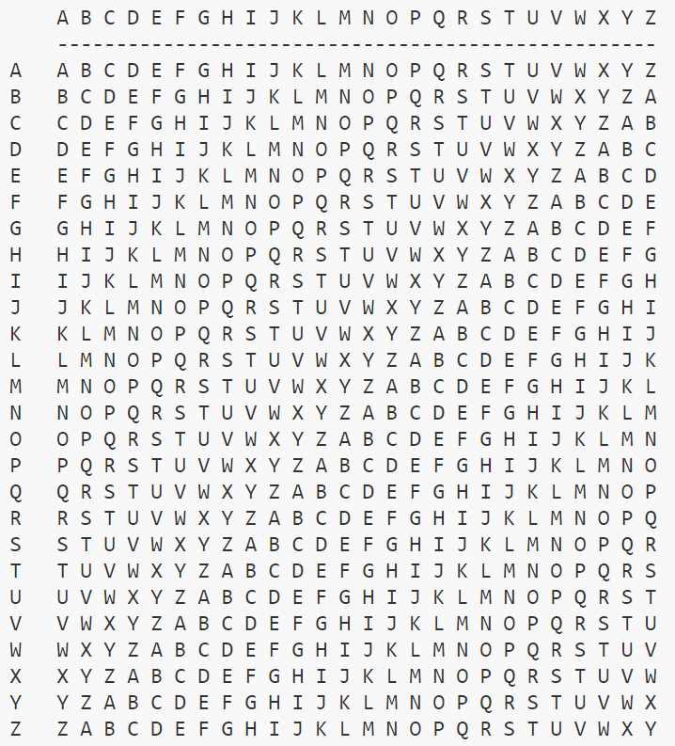
Vigenère and Gronsfeld Cipher
The Algorithm
The 'key' for a vigenere cipher is a key word. e.g. 'FORTIFICATION'
The Vigenere Cipher uses the following table to encipher the plaintext:

Slide 9


Vigenère and Gronsfeld Cipher
To encipher a message, repeat the keyword above the plaintext:
Now we take the letter we will be encoding, 'D', and find it on the first column on the tableau. Then, we move along the 'D' row of the tableau until we come to the column with the 'F' at the top (The 'F' is the keyword letter for the first 'D'), the intersection is our ciphertext character, 'I'.
So, the ciphertext for the above plaintext is:

Slide 10
Vigenère and Gronsfeld Cipher
Using the key: icsforyou
Decrypt: uchxoicoawqvboprczqpvbvvpsswwswsxmwho

Slide 11
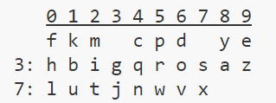
Straddle Checkerboard Cipher
The straddling checkerboard is a substitution cipher, except that the substitutions are of variable length.
The “key” for a straddling checkerboard is a permutation of the alphabet e.g. ‘fkmcpdyehbigqrosazlutjnwvx’ , along with 2 numbers e.g. 3 and 7. A straddling checkerboard is set up something like this (using the key information above):

Slide 12
Straddle Checkerboard Cipher
The first row is set up with the first eight key letters, leaving two blank spots. It has no row label.
The second and third rows are labelled with whichever two digits didn't get a letter in the top row, and then filled out with the rest of the key letters.
Since there are 30 slots in our grid, and we missed two letters in the first row, there will end up being two spare in the other rows. It doesn't matter where these spares go, so long as sender and receiver use the same system.

Slide 13
Straddle Checkerboard Cipher
To encipher, a letter on the top row is simply replaced by the number labelling its column. Letters on the other rows are replaced by their row number, then column number:
So, DEFEND THE EAST WALL OF THE CASTLE becomes 690975672309938377275387070360723094383772709.

Slide 14
Straddle Checkerboard Cipher
Using the following
key: kmcpdyehbigqrosazlutjnwvx
spare positions: 3 7
Decrypt the following message:
5353633353822327433470713135364137

